Slide 1








"Nurturing Faith in Young Hearts:
A Guide for PK-K Church School Teachers"
Presentation by V. Rev. Radovan Jakovljevic

Slide 2

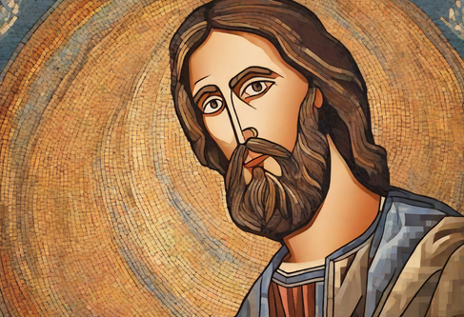
INTRODUCTION
Purpose of Training
NOTES
to equip PK-K Church School teachers with the necessary tools to engage young children while fostering their spiritual growth.
Emphasis of Training
to explain how critical the early years are in a child’s spiritual journey, focusing on making lessons relatable and engaging

Slide 3






UNDERSTANDING LEARNING STYLES IN
PK-K STUDENTS
Visual, auditory, kinesthetic learners
young children learn best through different modalities: visual (seeing), auditory (hearing), and kinesthetic (doing).
  How young children learn through play and repetition

Slide 4


ATTENTION SPAN AND CLASS LENGTH
between 20-30 minutes
Break the session into short, varied segments (5-10 minutes) to keep children engaged.
For example:
  start with a prayer,
  then storytelling,
  followed by a movement-based activity,
  and finally a craft.

Slide 5
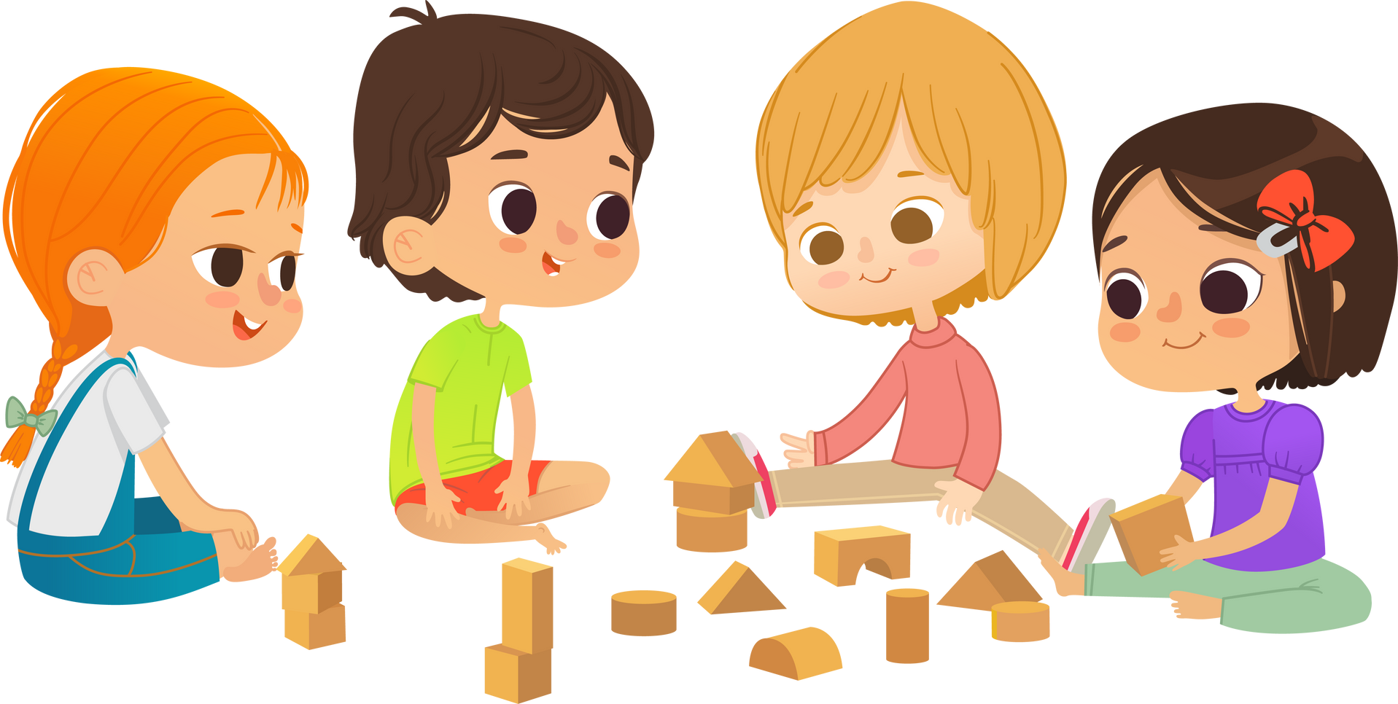
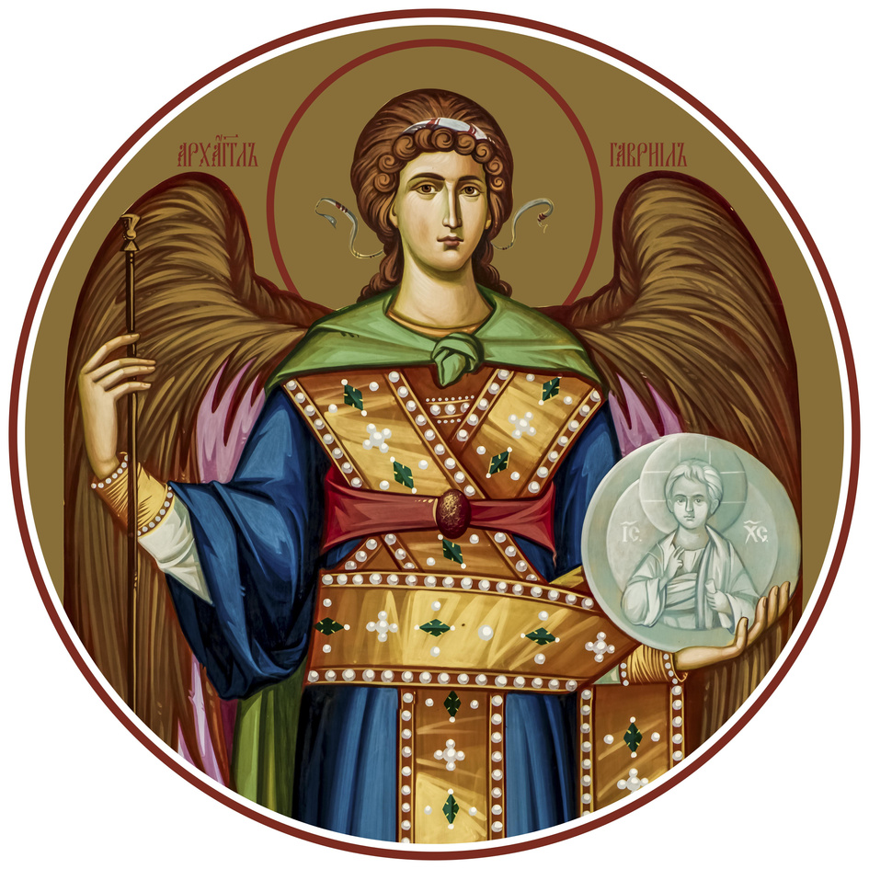
CLASSROOM ARRANGEMENT
How to organize a welcoming and functional classroom space for preschoolers.
An open floor plan where children can sit on the floor for story time,
have a prayer corner with icons,
and a designated table for crafts.
Importance of bright, simple visuals and keep distractions to a minimum. Ensure materials are accessible but not overwhelming.

Slide 6
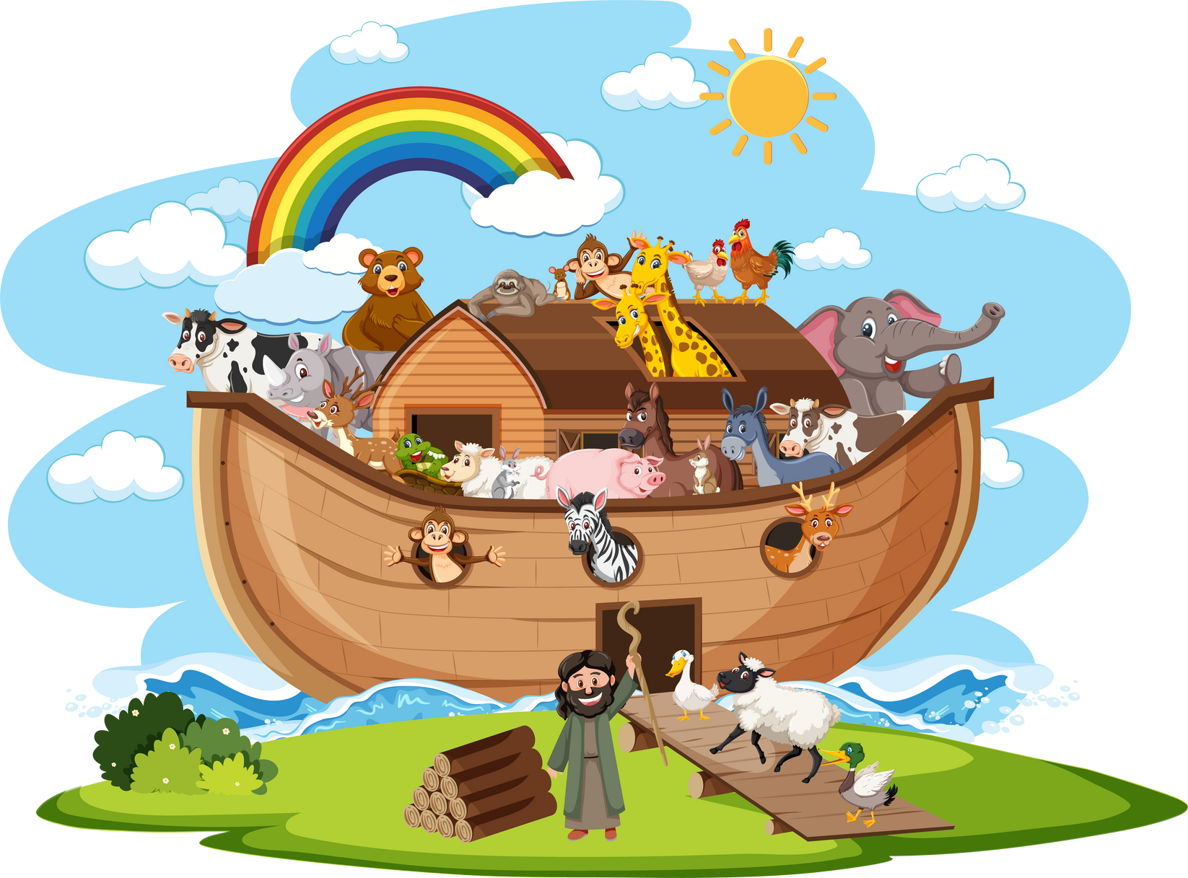
APPROPRIATE ACTIVITIES FOR PK-K
It is important to have different activities that are suitable for young children, such as crafting, storytelling, and singing.
1. create simple paper crafts based on Bible stories (e.g., Noah’s Ark animals),
2. act out Bible scenes
3. use songs and rhymes to teach prayers and lessons
4. activities should be short, fun, and hands-on.

Slide 7



AGE-APPROPRIATE BIBLE AND ORTHODOX CHRISTIAN FAITH CONCEPTS
What faith concepts and Bible stories children in PK-K can understand?
Focus on core, simple messages:
“God made the world,”
“Jesus loves you,” “
God is always with us.”
Use basic Bible stories like Creation, Noah’s Ark,
and Jesus feeding the
5,000.
The concepts should be concrete and relate to children’s lives, such as God’s love through family and friends.

Slide 8


BEHAVIORAL EXPECTATIONS AND MANAGEMENT
What are realistic expectations for behavior and strategies for managing classroom behavior?
Young children may struggle with sitting still or listening for long periods.
Incorporate routine (children thrive on knowing what to expect) and provide examples of calming techniques like quiet time after a busy activity.
Use gentle, positive reinforcement and redirection.

Slide 9






PLAYS, GAMES, AND ACTIVITIES
Incorporate interactive play to make learning fun and meaningful.
Simple Bible skits
Saints/Angels matching games
Use songs
Use movement activities
Coloring Pages

Slide 10

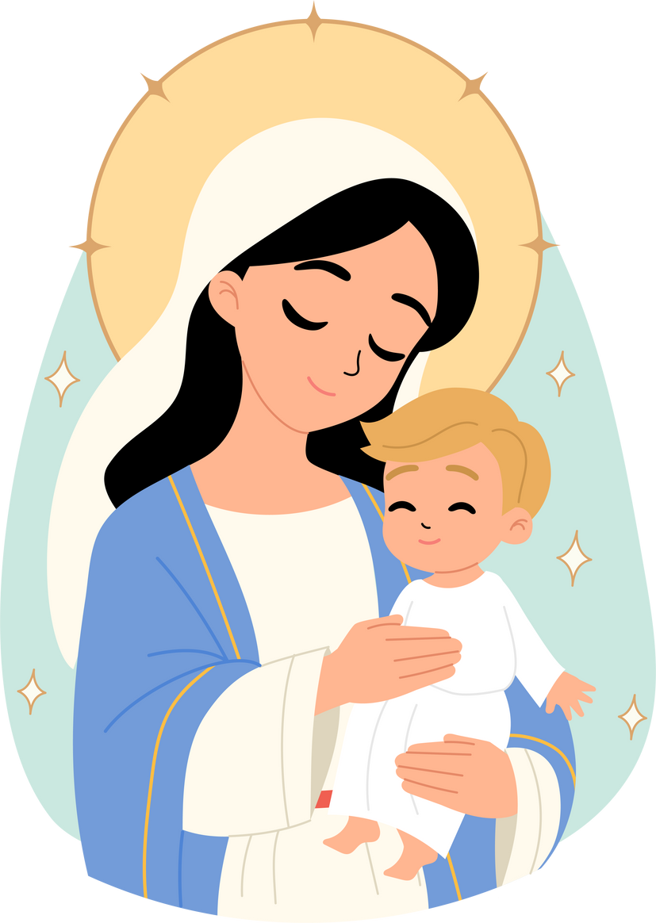
PARENTAL INVOLVEMENT
How to involve parents?
  Send home a weekly recap of what was learned.
  Include simple prayer or Bible story to read at home.
  Encourage parents to bring their children to Divine Liturgy regularly.
  Incorporate Orthodox practices, like evening prayers, into family life.
  Ask the parents to help and assist with projects.

Slide 11

IMPORTANCE OF PARTICIPATION IN DIVINE LITURGY
What is the value of having children attend and engage in the Divine Liturgy.
The big dilemma:
When should we hold the church school classes?
· teach them how to cross themselves
· how to venerate the Icon of Holy Cross properly
· how stand for prayers
· how to receive the Holy Communion properly
· How to light a candle
· teach them to observe what is going on during the Divine Liturgy

Slide 12
CURRICULUM OVERVIEW
Importance of structured yet flexible lessons.
The curriculum should cover core themes such as:
  Foundational Bible Stories: Creation, Noah’s Ark, Jesus’ love for children, and key Gospel stories that are relatable to young children.
  Liturgical Life: Introducing children to Orthodox prayers, the church calendar, saints, icons, and the sacraments, especially focusing on the Divine Liturgy and Holy Communion.
  Christian Values: Teaching kindness, sharing, forgiveness, and love through interactive activities and real-life applications.

Slide 13


ORTHODOX CHRISTIAN CHURCH SCHOOL CURRICULUM FOR
PRE-K AND KINDERGARTEN LEVEL STUDENTS
DRE Suggestions
1. GOD MADE THE WORLD
  Objective: Introduce children to the story of creation.
  Focus: God’s love and care in creating the world.
2. GOD MADE ME
  Objective: Help children understand that God makes them.
  Focus: Self-worth and being made in God’s image.
3. JESUS LOVES ME
  Objective: Teach about Jesus’ love for everyone.
  Focus: How Jesus shows His love and care for children.
4. THE CROSS OF JESUS
  Objective: Introduce the symbol of the cross and its significance.
  Focus: The cross is a sign of Jesus’ love and sacrifice.
5. ANGELS IN HEAVEN
  Objective: Explain the role of angels.
  Focus: Angels as God’s messengers and protectors.
6. JESUS’ BIRTH IN BETHLEHEM
  Objective: Introduce the Nativity story.
  Focus on Jesus as the greatest gift of love.
7. THE GOOD SHEPHERD
  Objective: Teach about Jesus as the Good Shepherd.
  Focus: How Jesus watches over and cares for us.
8. PRAYER IS TALKING TO GOD
  Objective: Introduce the concept of prayer.
  Focus: Simple prayers to talk to God every day.
9. THE MIRACLE OF THE LOAVES AND FISHES
  Objective: Tell the story of Jesus feeding the 5,000.
  Focus: God’s abundant love and care for our needs.
10. THE BEAUTY OF GOD'S CREATION
  Objective: Appreciate nature as God’s creation.
  Focus: How we can care for God’s world.
11. JESUS HEALS THE SICK
  Objective: Introduce the miracles of Jesus.
  Focus: Jesus’ love and power to heal.
12. THE TEN COMMANDMENTS
  Objective: Introduce simple concepts of right and wrong.
  Focus: God’s rules for loving Him and others.
13. LEARNING TO SAY “THANK YOU”
  Objective: Teach the virtue of gratitude.
  Focus: Thanking God in all things.
14. THE STORY OF NOAH'S ARK
  Objective: Introduce the story of Noah and the flood.
  Focus: Obedience and trust in God.
15. JESUS WELCOMES THE CHILDREN
  Objective: Teach that Jesus loves and welcomes children.
  Focus: Jesus’ special love for children.
16. THE STORY OF DAVID AND GOLIATH
  Objective: Teach about trusting in God’s strength.
  Focus: Courage and faith in God.
17. THE LIGHT OF CHRIST
  Objective: Introduce Jesus as the light of the world.
  Focus: Bringing Jesus’ light into our lives.
18. THE GREAT CATCH OF FISH
  Objective: Tell the story of Jesus calling the disciples.
  Focus: Trusting and following Jesus.

Slide 14



CURRICULUM ENHANCEMENT
Curriculum key elements
Stories
Crafts
Activities

Slide 15
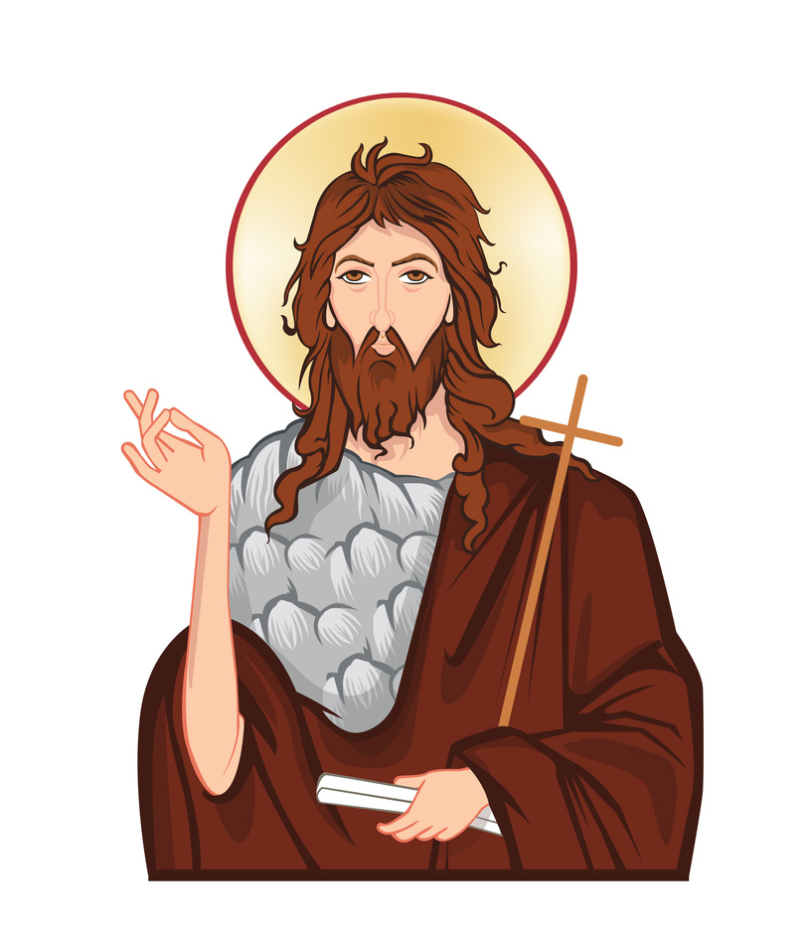
STORIES
Simplify the stories
Example:
God had a special job for John. When he was born, it was a miracle!
John lived in the desert. He wore clothes made from camel’s hair and ate bugs and honey.
John had an important message: "Say sorry to God for your mistakes!"
Many people came to hear John. He baptized them in the Jordan River to wash away their sins.
John was helping everyone get ready for Jesus!

Slide 16



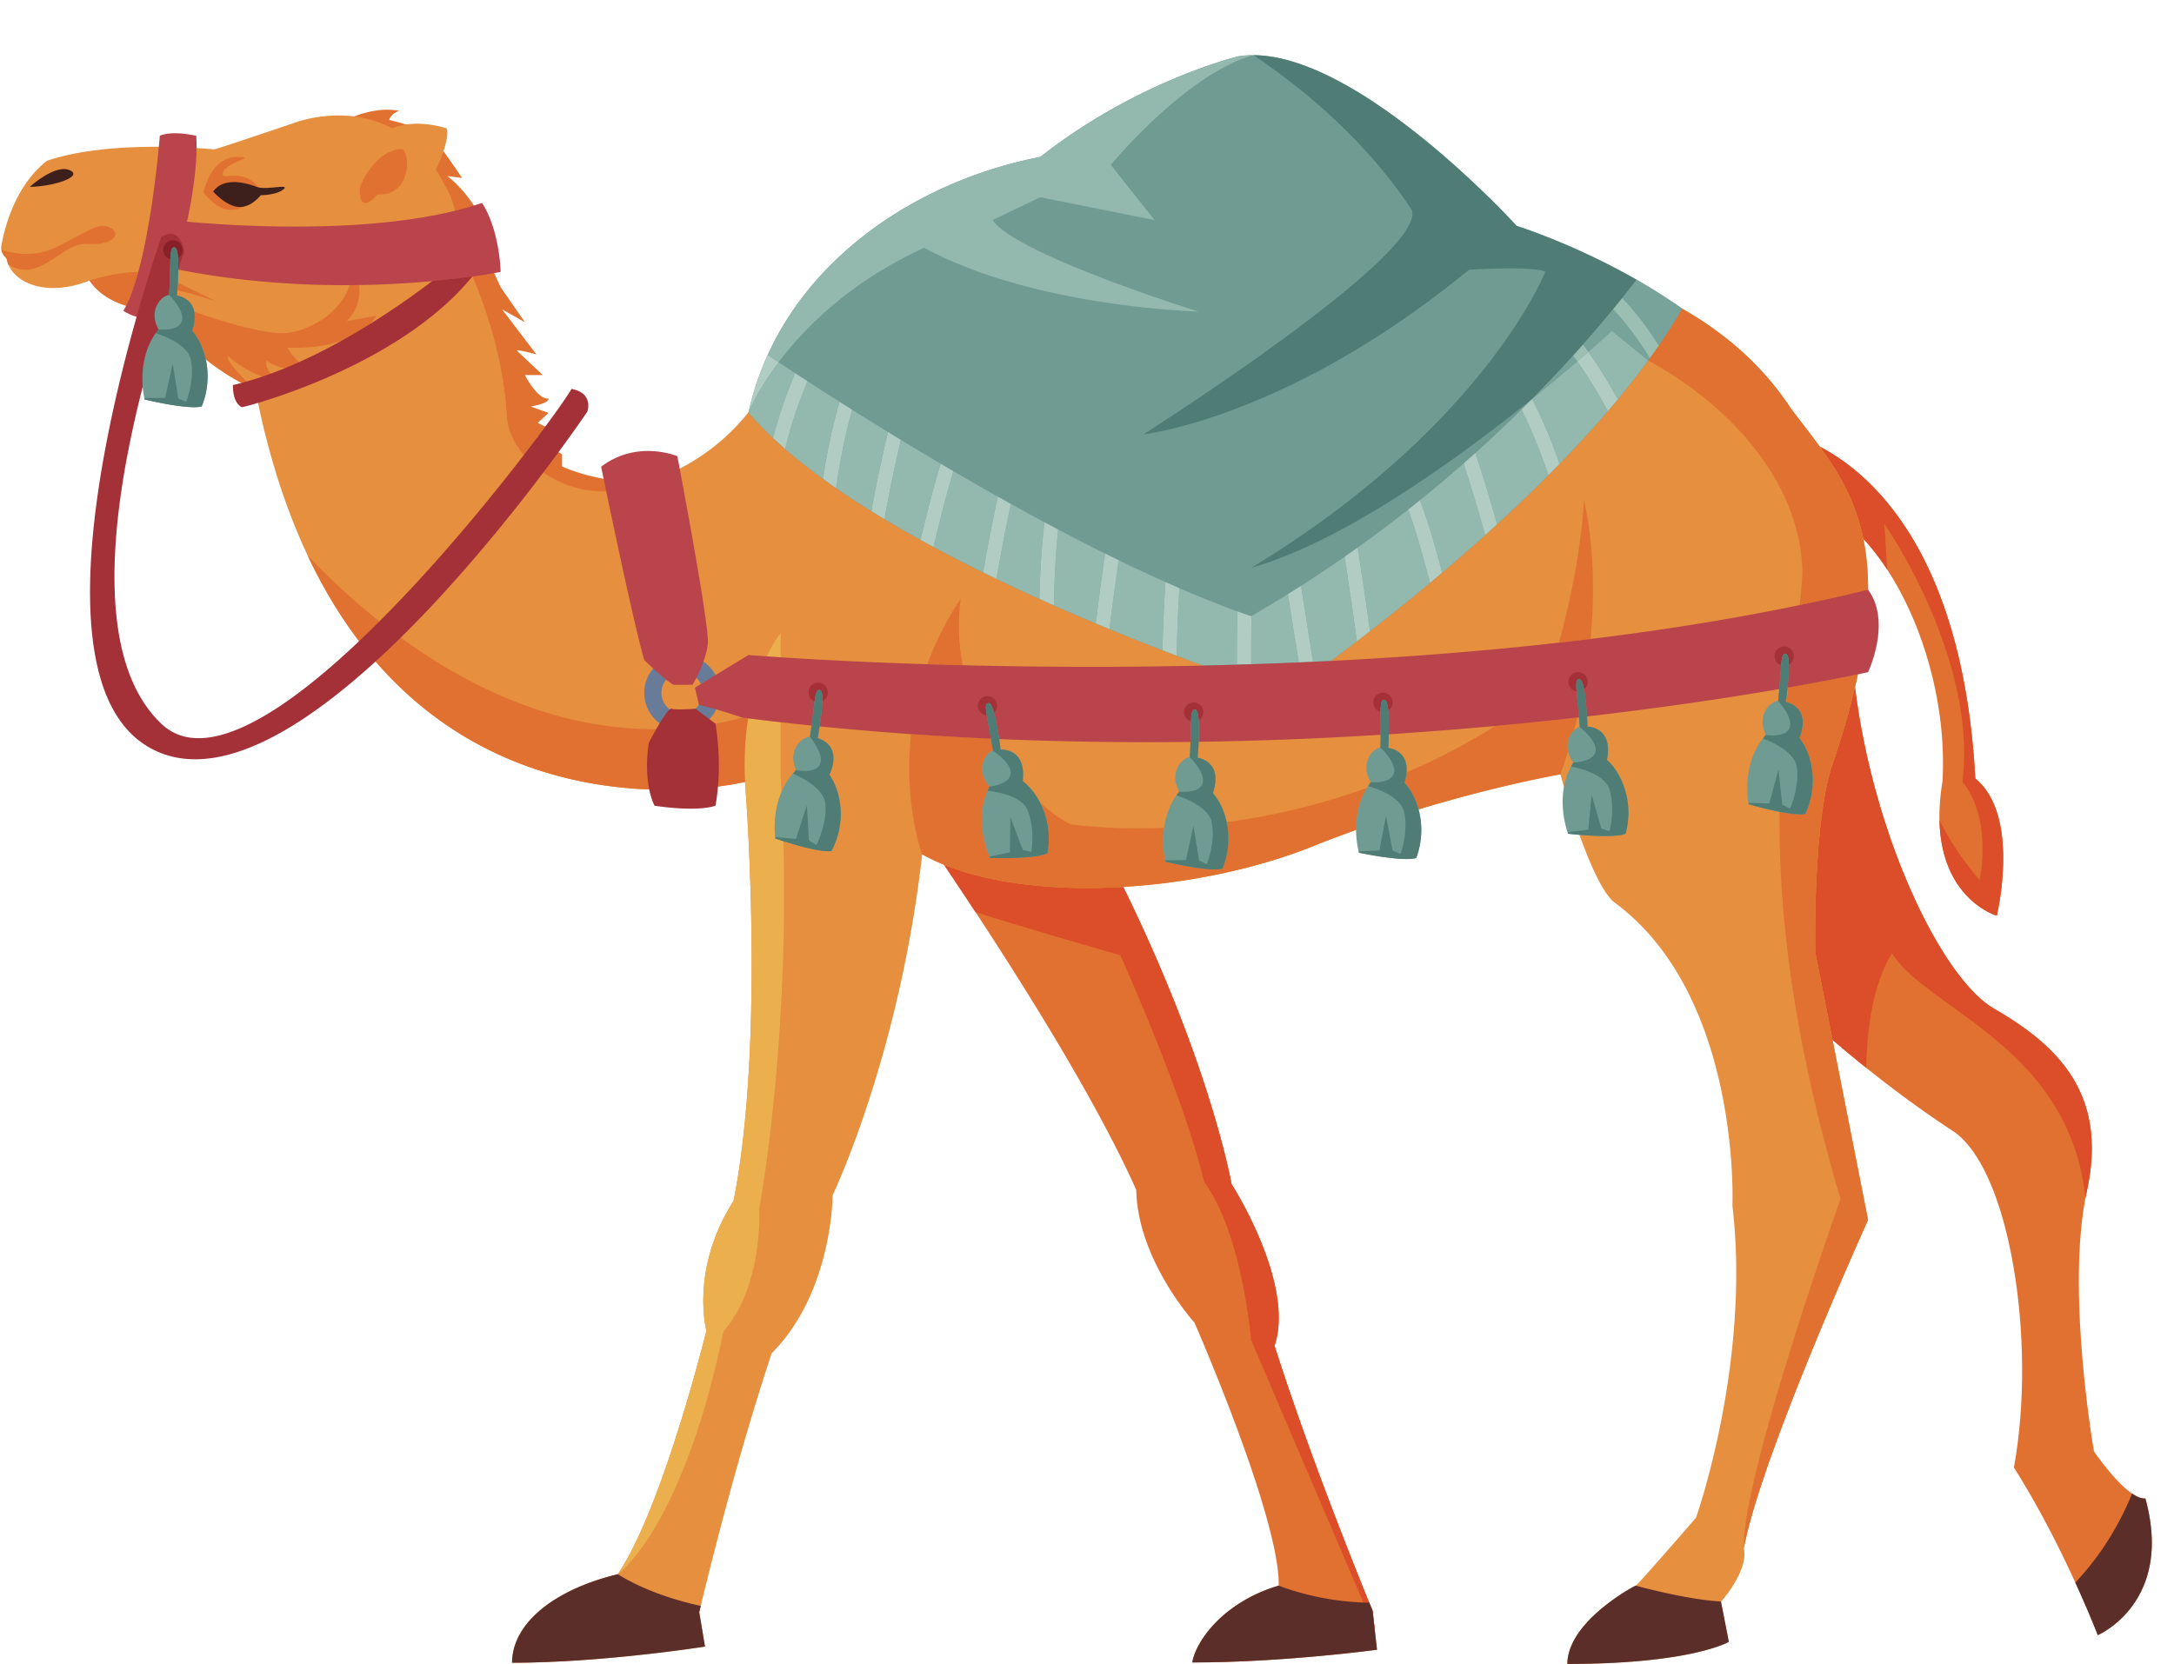

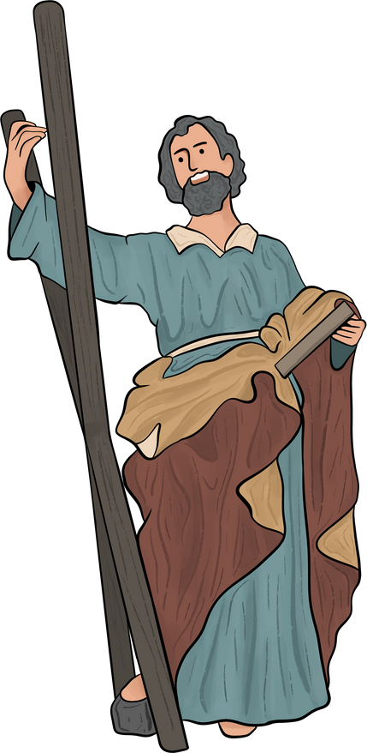

ARTS AND CRAFTS
"St. John’s Desert Scene" Craft
Materials:
  Brown construction paper (for the desert)
  Cotton balls or brown yarn (for John’s camel hair clothes)
  Green paper (for simple trees or bushes)
  Markers or crayons
  Glue sticks
  Scissors (teacher-supervised)
  Small cups of honey (optional)
Instructions:
  CREATE THE DESERT:
  Have the children glue a piece of brown construction paper onto a larger sheet to create the desert ground. Let them draw some rocks or simple desert plants with markers or crayons.
  MAKE ST. JOHN:
  Cut out a simple figure of St. John (pre-made templates are helpful). Let the kids color his face and hair, then glue on cotton balls or brown yarn to represent his camel hair clothing.
  ADD TREES OR BUSHES:
  Have the kids cut out small green shapes for bushes and glue them to the desert scene.
  Optional: Taste the Wild Honey!
  If allowed, give the children a small sample of honey to taste during the craft time. Talk about how St. John ate honey in the desert.
  WRAP-UP:
  As they finish, talk about how St. John lived simply in the desert and prepared the way for Jesus, just like they’ve made their own desert scenes.

Slide 17













COGNITIVE DOMAIN
Cross out animals and things
that do not belong in the desert

Slide 18


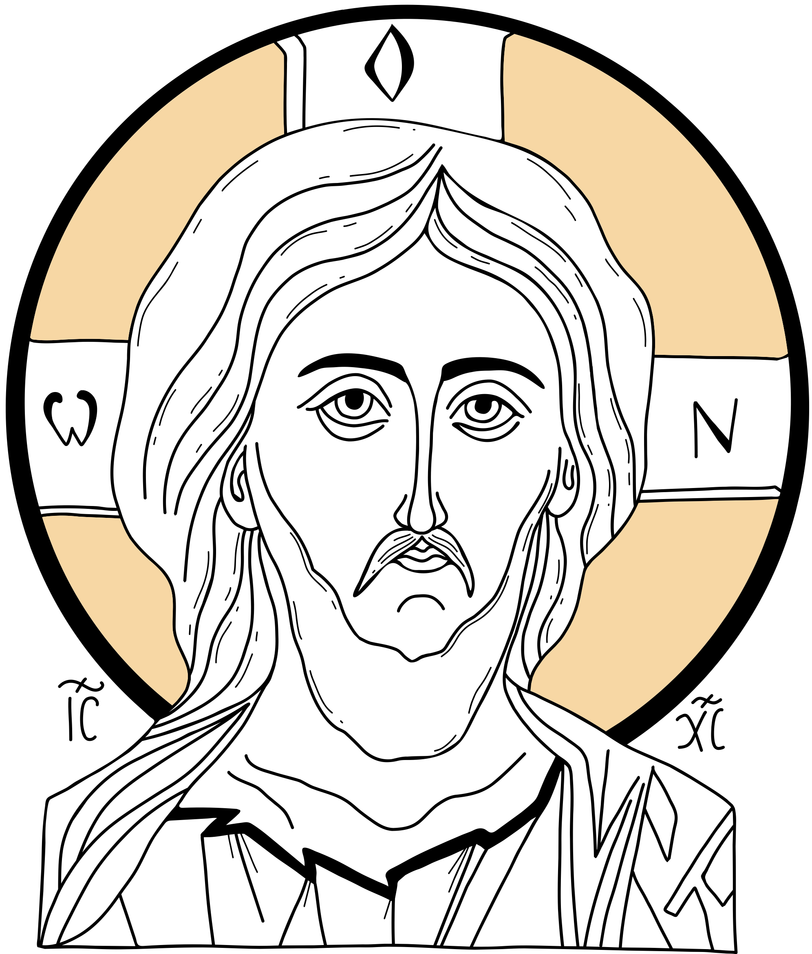

USING VISUAL AIDS AND PROPS
Use visual aids and props to enhance learning.
Remember to use icons, picture books, and simple illustrations to make abstract ideas more concrete.

Slide 19

OTHER IMPORTANT ASPECTS
The success of your PK-K program will also depend on:
  Involvement of Priest and Church Leaders
  Budgeting for the Church School
  Teacher Collaboration and Support
  Monitoring Progress and Growth

Slide 20

For more resources, please visit:
https://drenewgracanica.com/suggested-curriculum-for-2024-2025/

Slide 21

Thank you!

